Slide 1
CSC 222: Computer Organization & Assembly Language
4 – Processor Basics
Instructor: Anwar Khan

Slide 2
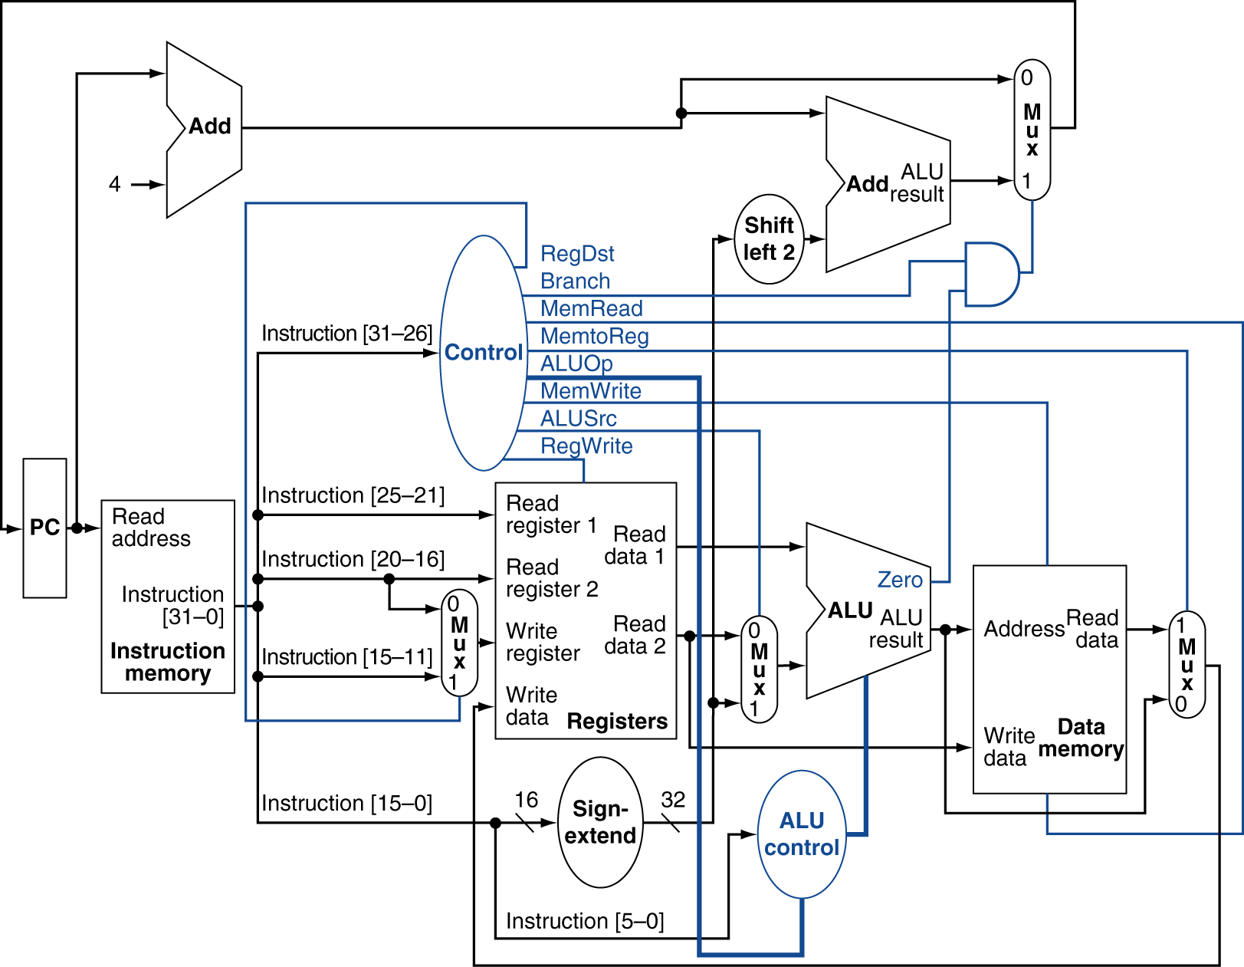
CPU Overview

Slide 3
Outline
Basic Operational Concepts
Processor Clock
Instruction Representation
Instruction Cycle

Slide 4
References
Chapter 1, Ytha Yu and Charles Marut, “Assembly Language Programming and Organization of IBM PC”
Chapter 3, William Stallings, “Computer Organization & Architecture”
Chapter 2, Subrata Ghoshal, “Computer Organization & Architecture”

Slide 5
Basic Operational Concepts

Slide 6
Machine Instruction Elements
Each instruction must have elements that contain the information required by the CPU for execution.
These elements can be:
Operation code: Specifies the operation to be performed (e.g.. ADD, I/O). The operation is specified by a binary code, known as the operation code, or opcode.
Source operand reference: The operation may involve one or more source operands, that is, operands that are inputs for the operation.
Result operand reference: The operation may produce a result. Also called destination operand.
Next instruction reference: This tells the CPU where to fetch the next instruction.
Reference: http://cnx.org/content/m29425/latest/

Slide 7
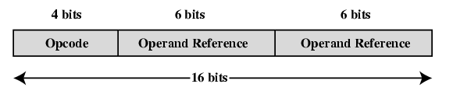
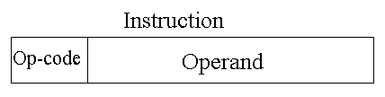
Instruction Representation
Within the computer, each instruction is represented by a sequence of bits.
16 bits instruction
4 bit opcode, 6 bit operand 1, 6 bit operand 2
4 bit opcode, 12 bit operand
32 bits instruction
64 bits instruction
Figure: A Simple Instruction Format

Slide 8
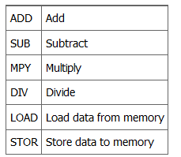
Contd..
Binary representations of machine instructions is difficult to remember.
Use a symbolic representation of machine instructions.
Opcodes are represented by abbreviations, called mnemonics, that indicate the operation. Common examples include:

Slide 9
Instruction Types
Data processing: Arithmetic and logic instructions
Data storage: Memory instructions
Data movement: I/O instructions
Transfer of Control: Test and branch instructions

Slide 10
No. of Addresses in an Instruction
Three addresses
Operand 1, operand 2, result
Two addresses
Source
Destination
One addresses
Source or Destination
Zero address
Zero-address instructions are applicable to a special memory organization, called a Stack. A stack is a last-in-first-out set of locations.

Slide 11
Types of Operands
Machine instructions operate on data.
The most important general categories of data are:
Addresses
Numbers
Characters
Logical data

Slide 12
Basic Operations – Processor
Execute the software by fetching instruction from memory
Look for any external signal and react accordingly
Input signals from keyboard or mouse etc.

Slide 13
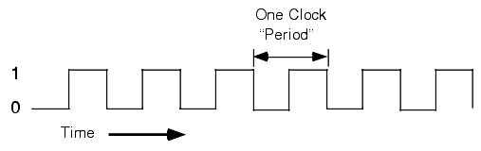
Processor Clock
Heart of any processor
Simple digital signals at equal time intervals
Alternate On Off states
All activity within the CPU is synchronized with the edges (rising or falling) of this clock signal.
Rising Edge
Falling Edge
Reference: http://www.plantation-productions.com/Webster/www.artofasm.com/Linux/HTML/SystemOrganizationa4.html

Slide 14
Program Counter (a.k.a. Binary Counter)
With every falling edge or rising edge (depending upon processor) of clock signal, the counter is incremented by one.
Width varies from processor to processor
The contents of PC are used as target address for the memory area
Microprocessor
Memory
Memory
Control Unit (CU)
Read
Read
PC
Address
Memory address
Data Buffer
Data
Data from Memory
Figure: Reading from memory

Slide 15
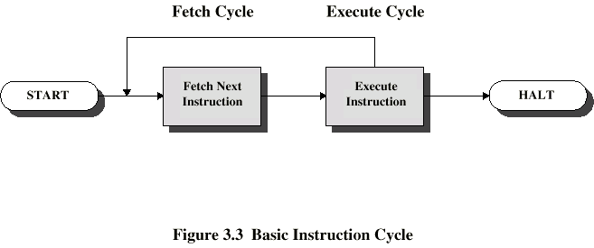
Basic Instruction Cycle
Fetch → Decode → Execute
Fetch
Fetch an instruction from memory
Decode the instruction to determine the operation
Fetch data from memory if necessary
Execute
Perform the operation on the data
Store the result in memory if needed

Slide 16
Contd..
Internal CPU Registers used in instruction cycle:
Program Counter (PC) = Address of instruction
Instruction Register (IR) = Instruction being executed
Accumulator (AC) = Temporary Storage

Slide 17
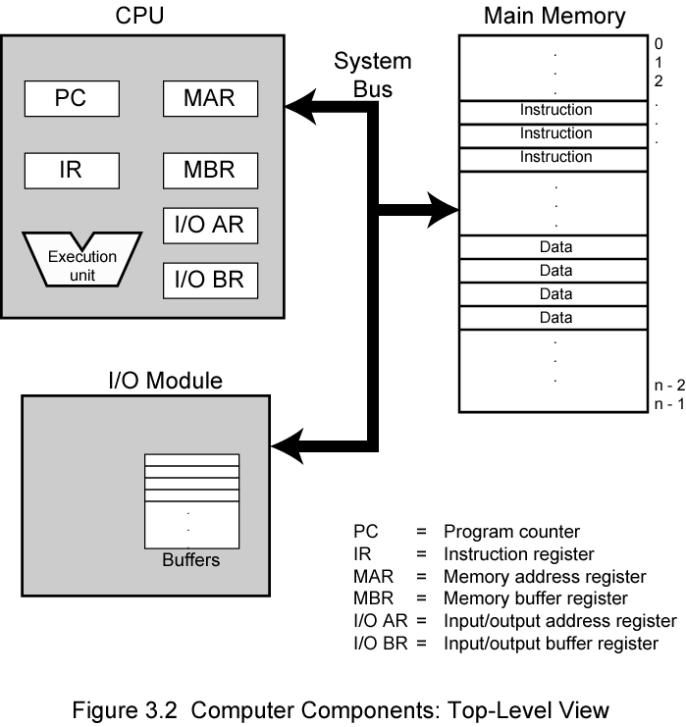
Computer Components: Top Level View Contd..

Slide 18
Detailed Steps
Address in the Program Counter register
Program Counter (PC) holds address of next instruction to fetch
Fetch the instruction from the memory
Increment the Program Counter
Unless told otherwise
Instruction loaded into Instruction Register (IR)
Decode the type of instruction
Fetch the operands
Execute the instruction
Store the results

Slide 19
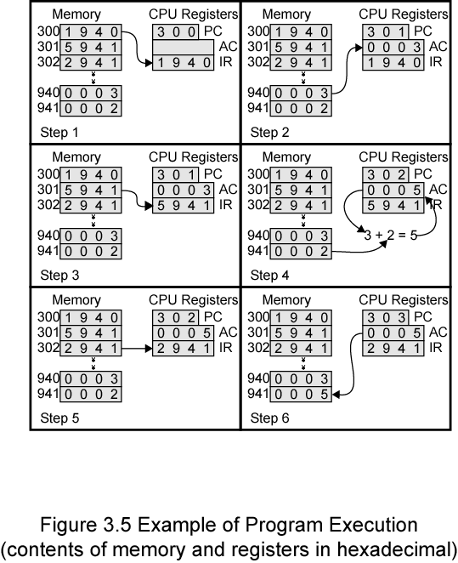
Example Program Execution

Slide 20
Instruction Execution Cycle

Slide 21
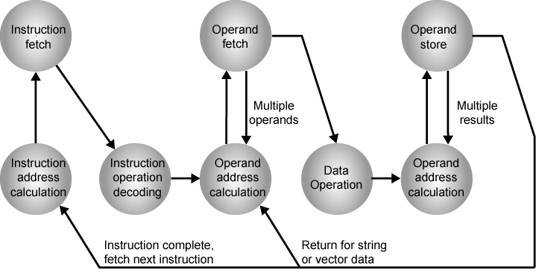
Instruction Cycle State Diagram
Notes:
Vector data

Slide 22
Contd..
Instruction Fetch
Read instruction from memory into processor
Instruction Operation Decoding
Determine the type of operation to be performed and operand(s) to be used.
Operand Address Calculation
If operation involves reference to an operand in memory or I/O, then determine the address of operand.
Operand Fetch
Fetch from memory or read from I/O
Data Operation
Perform the operation
Operand Store
Write into memory or out to I/O if required

